Slide 1

KS2 SATS 2026
KS2 SATS Guidance for Parents and carers

Slide 2



First things first...

Slide 3
KS2 Assessment – A Summary
  At the end of Key Stage 2 there will be an ‘expected standard’ set.
  A child must meet all the criteria consistently to get the ‘expected standard’ judgement.

Slide 4
NATIONALLY EXPECTED STANDARD
Children develop at different times and in individual ways, but at the end of Year 6 the DfE guidelines are as follows:
Children not meeting the WORKING TOWARDS ‘Nationally Expected Standard’ category for a pupil at the end of Year 6
WORKING TOWARDS the ‘Nationally Expected Standard’ for a pupil at the end of Year 6
WORKING AT the ‘Nationally Expected Standard’ for a pupil at the end of Year 6
WORKING AT GREATER DEPTH within the ‘Nationally Expected Standard’ for a pupil at the end of Year 6
This will be seen on the final report.
REMEMBER – ALL CHILDREN ARE DIFFERENT!

Slide 5


Slide 6
WHAT WILL BE ASSESSED OUTSIDE OF SATs?
CONTINUOUS TEACHER ASSESSMENT
WRITING
CONTINUOUS TEACHER ASSESSMENT
SCIENCE

Slide 7
WRITING 2026
There is a greater focus on the progress children make in writing throughout the school year, as opposed to a test-day snapshot of what they know.
DfE Guidance:- TA provides a rounded judgement that:
  is based on knowledge of how the pupil has performed over time and in a
  variety of contexts
  takes into account strengths and weaknesses of the pupil’s performance
  Teachers will assess children’s writing composition. Children’s results for English writing will be a judgement of their work throughout Year 6.
  Children's grammar, punctuation and spelling skills will be assessed as part of their writing, but their creativity and writing style will also be evaluated.
  Schools will moderate their judgements with other local schools and may be moderated by their Local Authorities too.

Slide 8

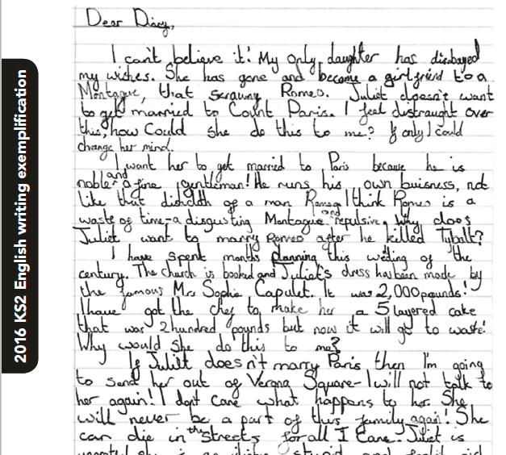
What is the
‘Expected Standard’ in writing?
The DfE have issued some guidance for schools.
Children are expected to be able to write using a range of different genres.

Slide 9
SCIENCE 2026
Teachers will assess children’s knowledge and understanding of science and will judge their scientific skills according to the National Curriculum Interim Framework for Science.
Children’s results for science will be a judgement of their work throughout KS2.

Slide 10
SATS 2026
Key stage 2
English reading
English grammar, punctuation and spelling
Mathematics
Each pupil registered for the tests will receive:
  a raw score (number of raw marks awarded)
  a scaled score
  confirmation of whether or not they attained the national standard

Slide 11

SCALED SCORES
  Tests at the end of KS2 will report in scaled scores.
  The ‘expected standard’ will always be set at 100.
  Raw scores in the test will be converted to scaled scores.
  The ‘raw score’ that equates to 100 might be different each year.
  Pupils who score 100 or more will have met the ‘expected standard’. EXS
  Pupils who score below 100 will not have met the ‘expected standard’. NME/HNM

Slide 12
READING 2026
ASSESSED BY TEST (marked externally)
PAPER 1
  This test consists of a reading answer booklet and a separate reading booklet.
  Pupils will have a total of 1 hour to read the 3 texts in the reading booklet and complete the questions at their own pace. They can approach the test as they choose: e.g. working through one text and answering the questions before moving on to the next.
60 minutes

Slide 13
READING SKILLS ASSESSED
The most crucial aspects of reading at the end of Key Stage 2 are:-
  Accuracy (decoding familiar and unfamiliar words correctly)
  Fluency (speed and confidence)
  Comprehension (drawing meaning from text)
  Understanding, describing, or retrieving information, events or ideas from texts and using quotation and reference to text.
  Deducing, inferring or interpreting information, events or ideas from texts.
  Identifying and commenting on the structure and organisation of texts.
  Explaining and commenting on the writers’ use of language.
  Identifying and commenting on writers’ purposes and viewpoints.
  The overall effect of the text on the reader.

Slide 14
SPAG 2026
English - Spelling, Punctuation and Grammar
ASSESSED BY TEST (marked externally)
PAPER 1
45 minutes to complete the test, answering the questions in the test paper (50 questions).
PAPER 2
(Spelling)
This component consists of an answer booklet for pupils to complete and a test transcript to be read by the test administrator.
Pupils will have approximately 15-20 minutes to complete the test (not strictly timed), by writing the 20 missing words in the answer booklet.

Slide 15
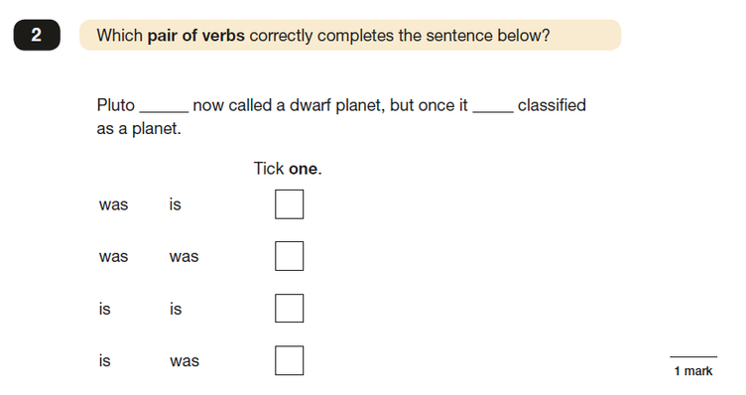
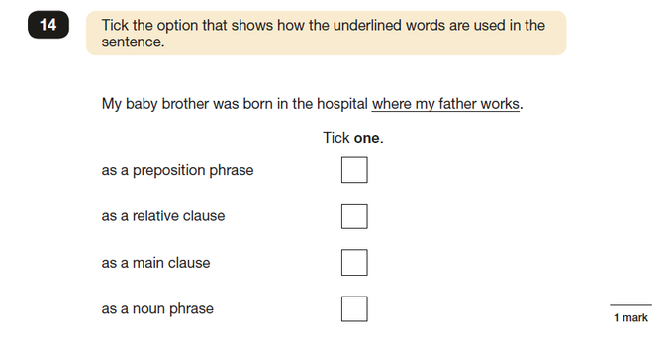
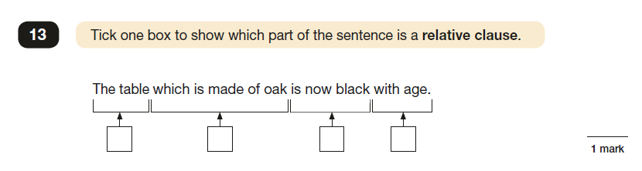
English Grammar, Punctuation and Spelling
Sample questions

Slide 16
MATHS 2026
ASSESSED BY TEST (marked externally)
PAPER 1
Arithmetic - 30 minutes.
PAPER 2
Reasoning - 40 minutes.
PAPER 3
Reasoning - 40 minutes.
The tests have questions of 1 and 2 marks and children are given marks for working out if they finish the task, but get the answer incorrect.
NO CALCULATORS are allowed.

Slide 17
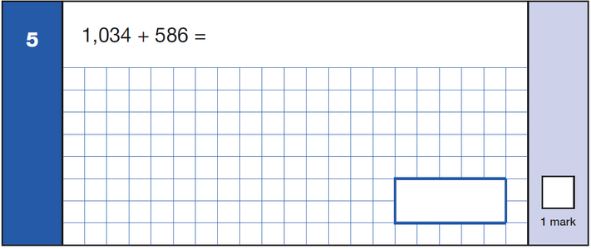
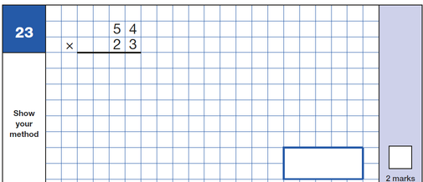
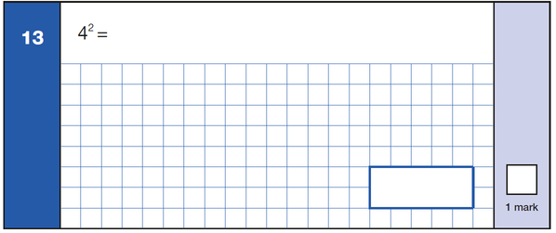
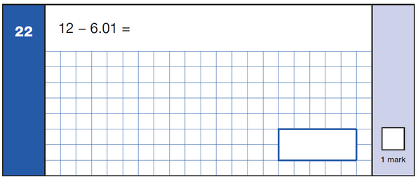
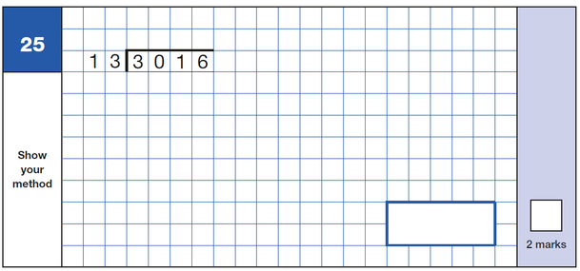
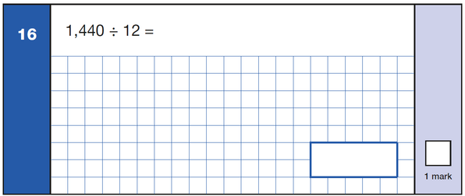
Sample arithmetic questions
Notes:
Add link from website
<number>

Slide 18
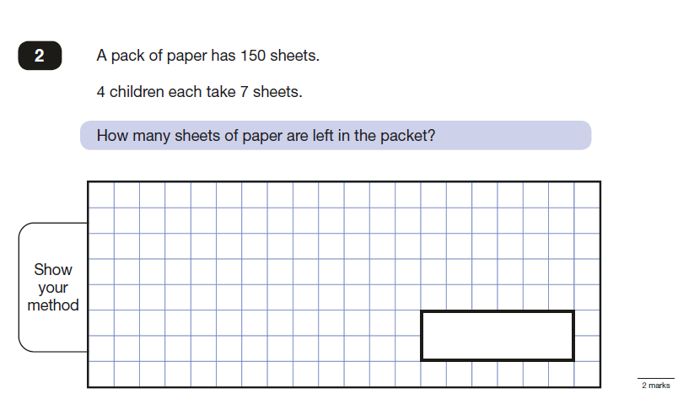
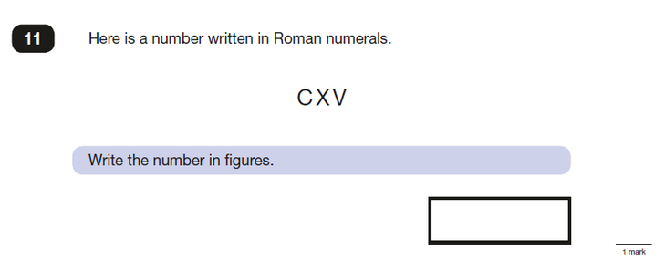
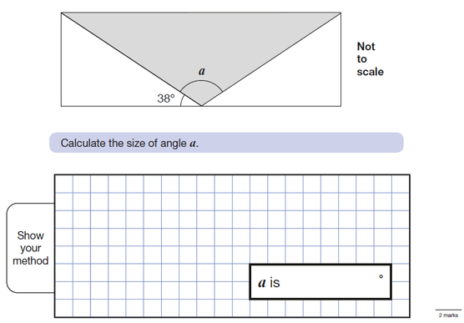
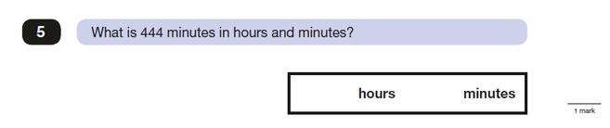
Sample reasoning questions

Slide 19
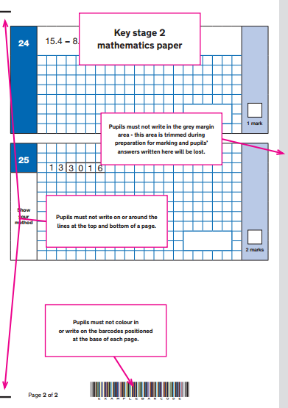
PREPARING CHILDREN FOR ON-SCREEN MARKING
All key stage 2 tests will be marked on screen.
To help ensure that pupils’ test scripts can be scanned and their answers read and marked on screen, children must follow the advice given to them by their teachers about where to mark put their answers and where they can write on their papers.

Slide 20
MOCK WEEK
Mock week will take place on the week commencing 9th March 2026.
We will follow the exact timetable of the SATS week.

Slide 21
WHEN ARE THE TESTS?
All KS2 SATs will be held in the week beginning 11th May 2026.
The tests must be taken on the scheduled days.
Monday 11 May | English grammar, punctuation and spelling test, Paper 1, short answer questions. English grammar, punctuation and spelling test, Paper 2, spelling.
Tuesday 12 May | English reading test, reading booklet and associated answer booklet.
Wednesday 13 May | Mathematics, Paper 1, arithmetic test. Mathematics, Paper 2, reasoning.
Thursday 14 May | Mathematics Paper 3, reasoning.
Absence during the test period - Pupils who miss one or more component of a test and do not qualify for a timetable variation will not be awarded a score for that test.

Slide 22
How are we preparing?
  Teaching the more challenging learning objectives set out in the National Curriculum
  Continuous Assessment
  Focused Maths Lessons
  Focused Spelling Lessons
  Focused SPaG Lessons (Spelling, Punctuation & Grammar)
  Guided and Independent Reading
  Writing Assessments carried out regularly
  MOCKs
  Practising previous SATS papers
  Teaching ‘test techniques’ and vocabulary
  Home Learning to support teaching & learning in school
  Mentoring and support
  Keeping up to date with information provided by the DfE

Slide 23
HELPING AT HOME
  Try not to put pressure on your child – you know your child best.
  Support with homework and targets that have been discussed at Parents Evening.
  Read regularly and discuss a variety of texts – not just ‘listening’ to your child read.
  Short bursts of mental maths, times tables and problem solving etc.
  Use the previous test papers only if advised by school as they are used in school as assessment and practise for the children. Using the same papers at home makes it difficult to prepare the children adequately.
  Useful website - maths.com, spag.co.uk and TTRS

Slide 24
SPECIAL EDUCATIONAL NEEDS & DISABILITIES
Some support can be given to children who have an Educational Health Care Plan.
Requests for additional time will be made by teachers using their knowledge of children and the children’s individual needs.
Children who are unable to sit and work for a long period because of a special educational need, or disability, or because of behavioural, emotional or social difficulties may receive some support.
Children with English as an additional language and who have limited fluency in English may receive some support.

Slide 25
REPORTING RESULTS
  Teacher assessments will be passed on to Year 7 so the results can be used in planning for KS3 teaching.
  The test results are available mid-end of July.
  Written reports are given at the end of the summer term along with your child’s results and the results for school.

Slide 26
WE RECOMMEND:-
Early nights and lots of sleep
Good attendance
Good punctuality
A good breakfast
LOTS OF PRAISE AND ENCOURAGEMENT!

Slide 27
ANY QUESTIONS?
?
Notes:
<number>

